Slide 1
Further Resources

Slide 2
http://bit.ly/chefconf2015
The slides from this workshop and all the workshops from ChefConf 2015

Slide 3
http://bit.ly/cheftraining
The training material for Chef Fundamentals and Extending Chef classes.

Slide 4
http://learnchef.com

Slide 5
http://docs.chef.io

Slide 6
youtube.com/user/getchef

Slide 7
youtube.com/user/getchef

Slide 8
irc.freenode.net#chef
Meetings every two weeks

Slide 9

Learning Chef
A Guide to Configuration Management and Automation

Slide 10
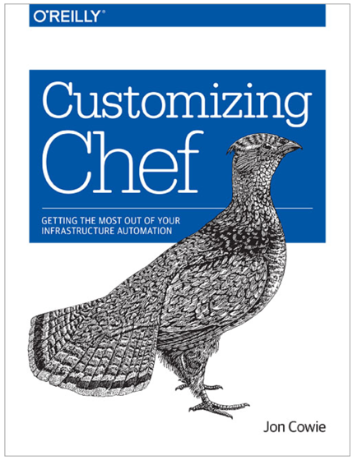
Customizing Chef
Getting the Most Out of Your Infrastructure Automation

